Slide 1
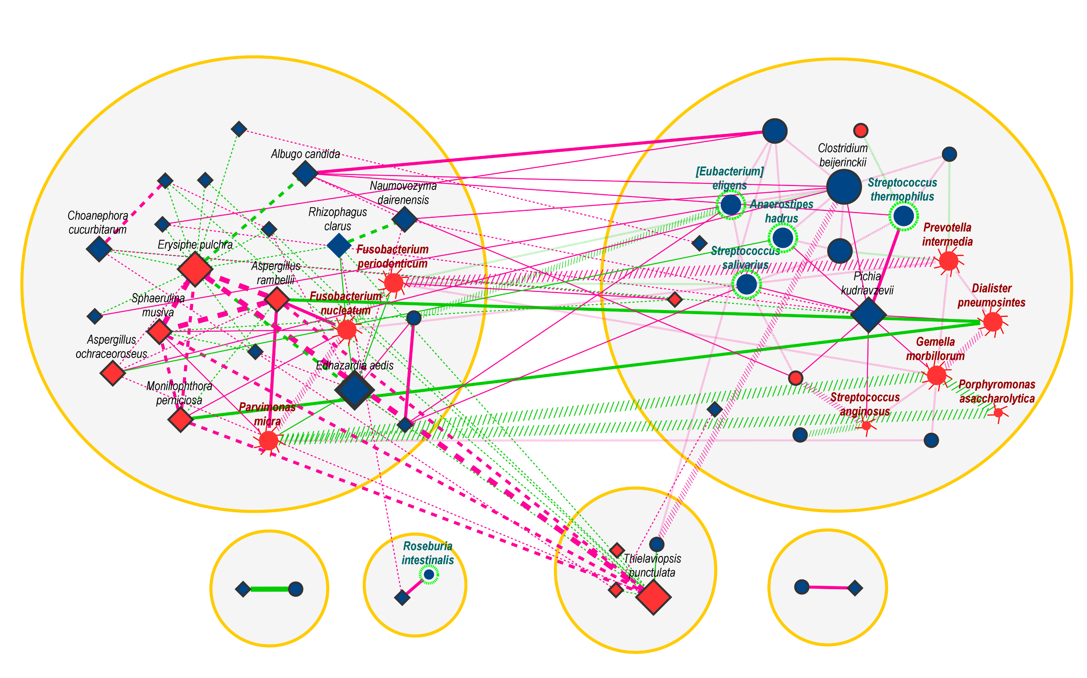



Figure 6
a
Network for the differential correlation of fungi and bacteria between CRC and control
Fun_Cluster
Bac_Cluster
CRC Enriched
CRC Depleted
Reported potential
probiotic
Reported potential
pathogens
Unreported bacteria
Fungus
Counts_{corr} ≤ 5
5 < Counts_{corr} ≤ 10
10 < Counts_{corr}
z-score < 0 [Corr_{CRC} > Corr_{Ctrl} ]
z-score > 0 [Corr_{CRC} < Corr_{Ctrl} ]
External Correlation
Bacterial Correlation
Fungal Correlation
Abs(z-score) ≤ 5
5 ≤ Abs(z-score) < 6
6 ≤ Abs(z-score)

